Slide 1

SALES TRENDS AND CUSTOMER BEHAVIOR

Slide 2
Olist is a Brazilian e-commerce platform that connects small and medium-sized businesses to customers across Brazil.
The platform operates as a marketplace, where merchants can list their products and services and customers can browse and purchase them online.
The dataset has information of 100k orders from 2016 to 2018 made at multiple marketplaces in Brazil. With multiple dimensions: from order status, price, payment and freight performance to customer location, product attributes and finally reviews written by customers
Introduction

Slide 3
Outcomes
Identify top 5 product_catergory and state has most sales
Identified peak sales periods and trends by day, week, and month.
Visualized repeat purchase behavior and retention rates over time.
Performed RFM segmentation to group customers into categories
Provide actionable recommendations for increasing retention and repeat customer rate
Purpose
Identify top product category and state by sale
Analyze sales trends over time to identify seasonality, growth patterns, and sales fluctuations.
Uncover insights to help improve customer retention, marketing targeting, and sales strategy.
Segment customers based on purchasing habits and engagement.
Discover customer behavior

Slide 4
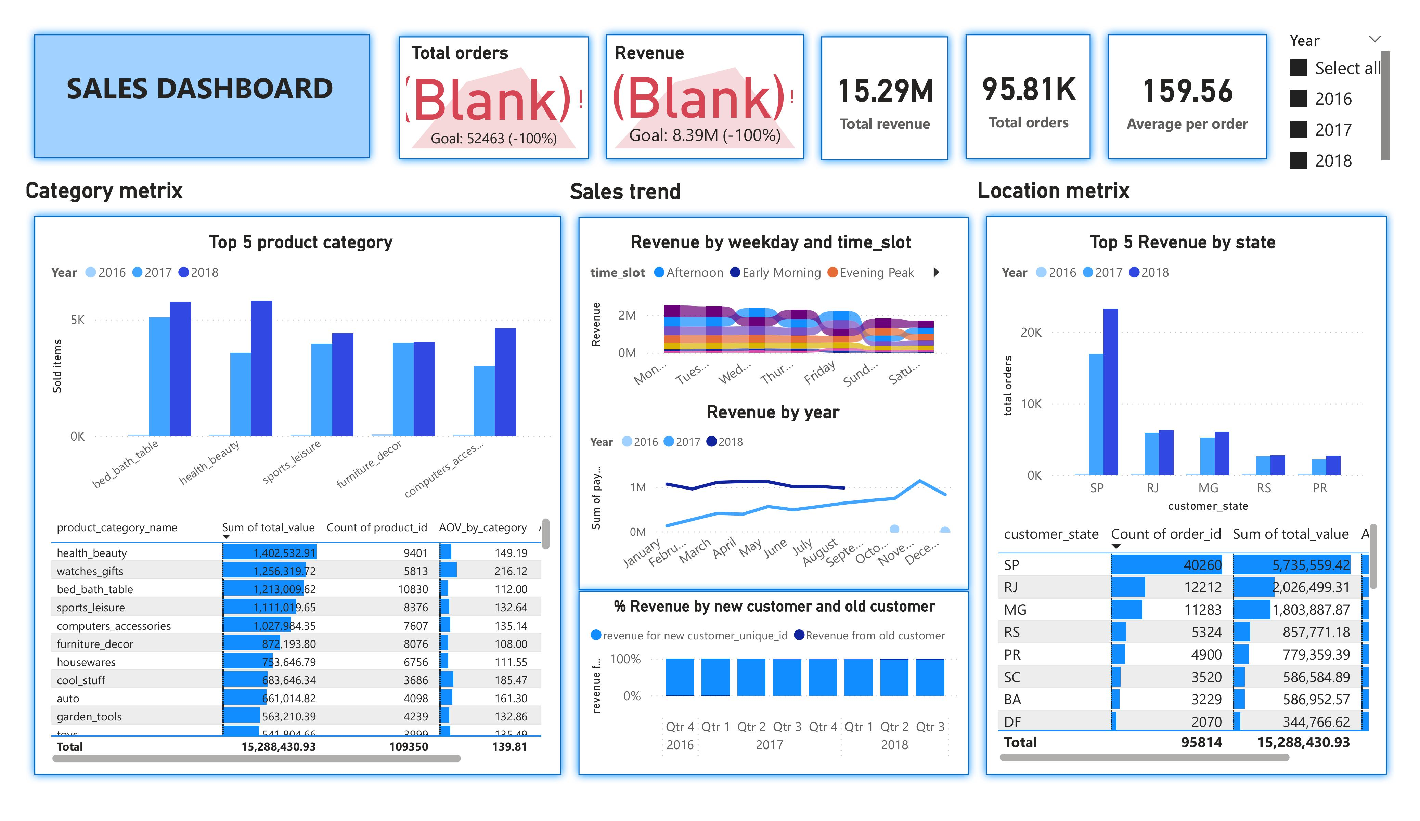

Slide 5
Insights
Revenue and total order number inscreased year by year
Through the year, Nov,Dec and Jan are the month have most sales
Orders placed in monday and tuesday bring more revenue than other days in week. Whiles, afternoon and late night also bring more revenue than other time in a day
Top 5 states have highest revenue : SP, RJ, MG, RS, PR,
Bed_bad_table, health_beauty, Sport_lesure, computer accessories, watch_gift these product groups have highest revenue and demand in this period.
Most revenue is contribued by new customer (about 99%)

Slide 6
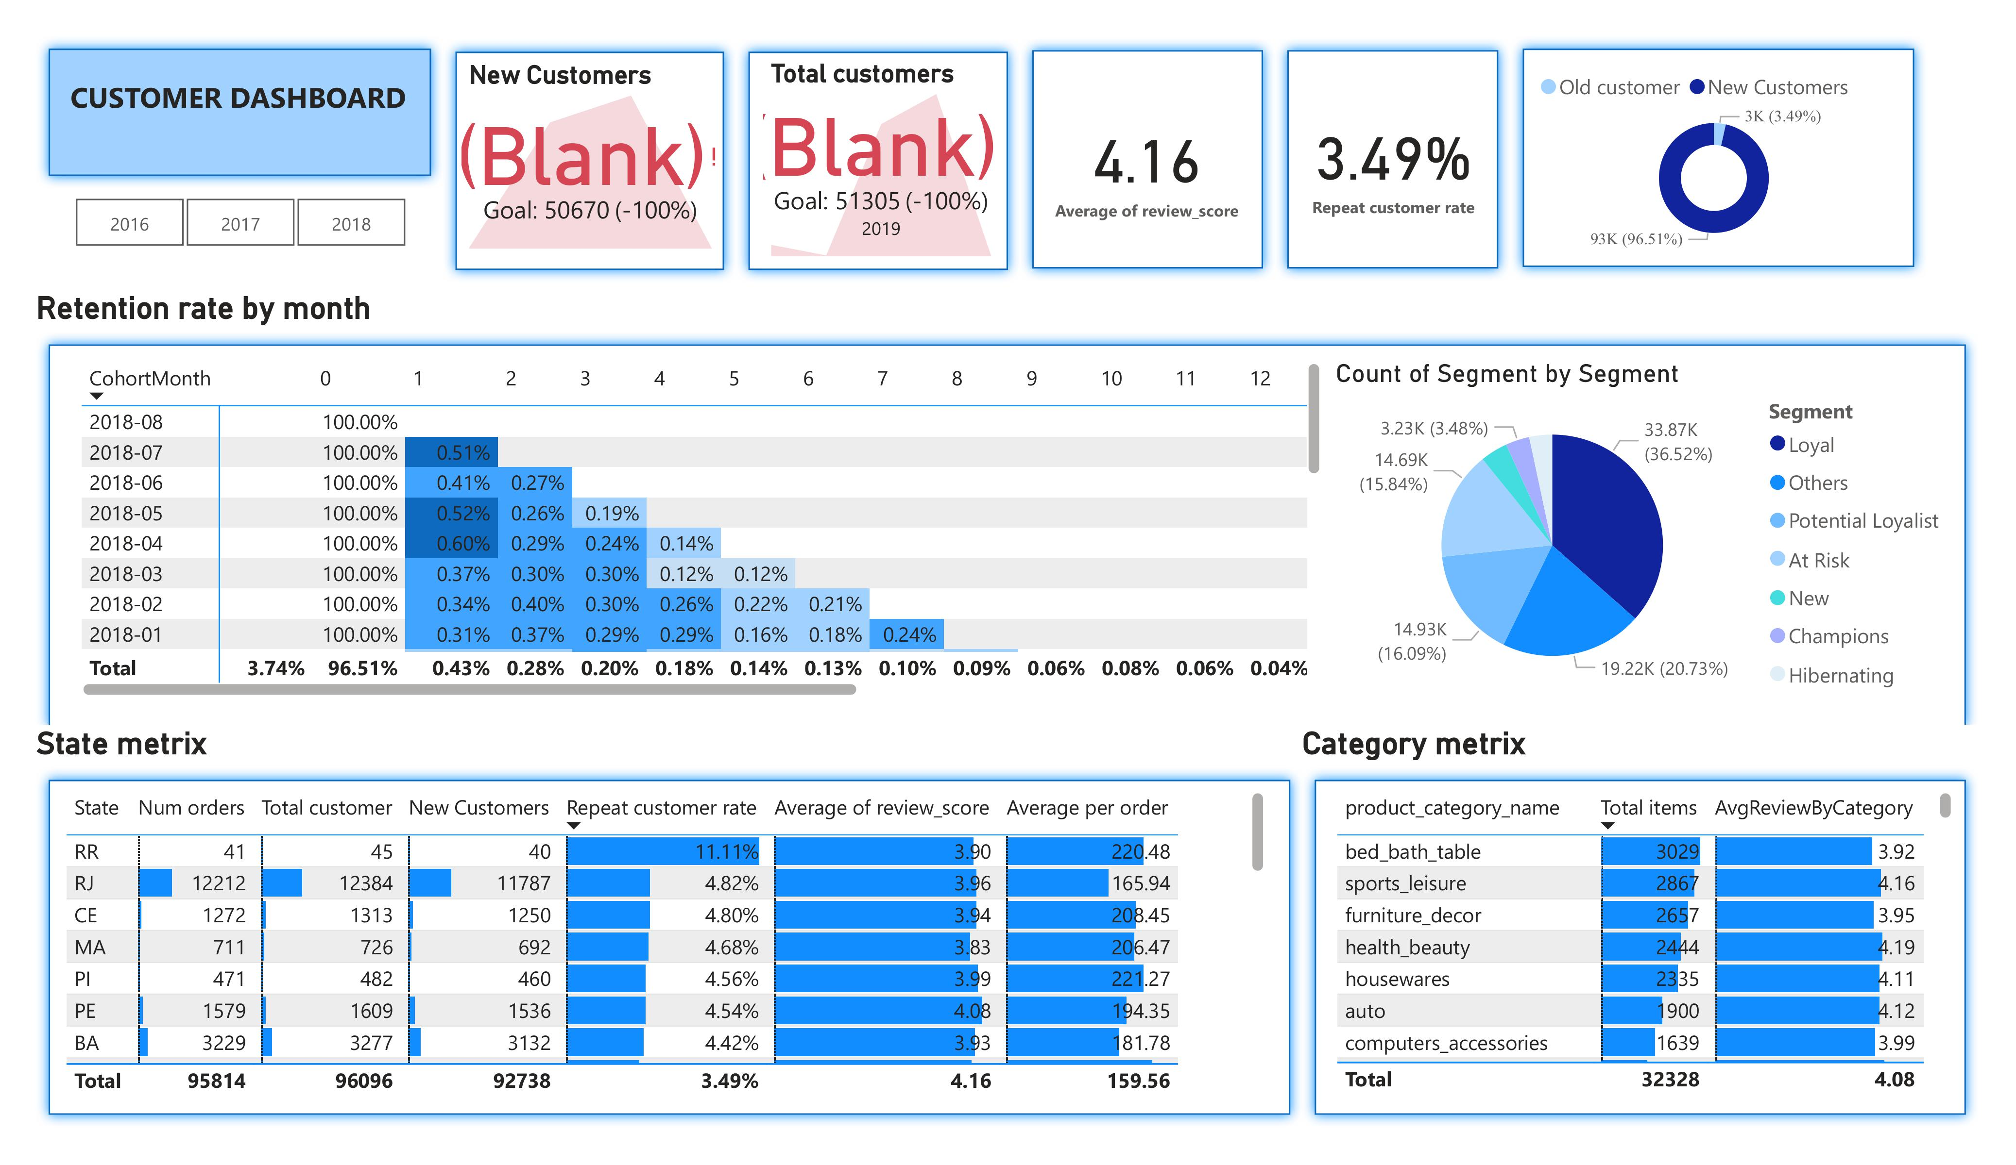

Slide 7
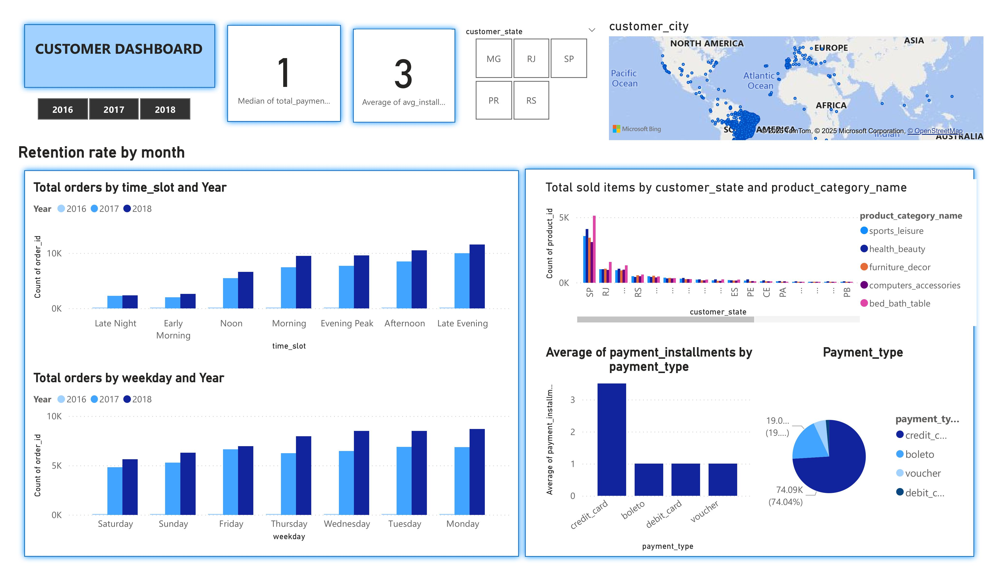

Slide 8
Customer behaviors
Majority order has 5 start rate (average 4.16)
Many customer located in SP, RJ, MG, RS, PR but most of them buy one order only
Customer in 5 these states RR, RJ, CE, MA, PI are top 5 states which have highest repeat customer rate
Customer prefer to buy these product in olist Bed_bad_table, Sport_lesure, furniture decor, health_beauty, houseware
Customer prefer to use credit card to pay order
Most Customer pays once for the order.
Buyer tend to buy product in late night or afternoon, on monday and Tuesday.
Retention decline over the time with low rate in all cohort month.
customer buy more item in order will have higher rate to buy more.
Customer tend to give higher score review if shipping time is shorter

Slide 9
Recommendation
Customize promotion for customer type depending on type of product which that type of customer interest in each state. Focus on 5 states has the highest revenue/solds and 5 states have highest average per order (state customer willing to pay more in each order)
Retention Programs: We can send email with coupon for second order, cross-sell base on type the most selling product in customer state and product in the last orders.
Marketing email should be sent in afternoon or late night since this time customer active the most.
Make a combo product

Slide 10

THANK YOU!

